Slide 1
Mapping Discovery Nicoleta Preda
Notes:
Hello everybody I am Maria Koutraki from Univ of Paris Saclay and today I will present you the joint work with my advisors, Dan Vodislav and Nicoleta Preda entitled
“Deriving…..”

Slide 2
Federated Databases
Query reformulation
Query
Logical query plan
Query optimizer
Physical query plan
Execution engine
Re-planning request
wrapper
wrapper
wrapper
wrapper
wrapper
source
source
source
source
source

Slide 3











Which Web Services?
More than 12000 APIs* from various domains:
Search (3200 APIs)
Social (3000 APIs)
Traveling (1200 APIs)
Music (1000 APIs)
Financial (1200 APIs), Science (600 APIs), Weather (300 APIs)
*Source: ProgrammableWeb.com
Notes:
According to ProgrammableWeb.com there are more than 12 thousand WS APIs right now in the web from various domains like, music, movies, traveling, geodata even social data.

Slide 4



RDF Integration
Application example: automatic computation of vacation plans
Singers, Albums, Songs
Countries, Cities, Airports
Web Services API
Web Services API
RDF
Web Services API
Web Services API
Traveling Related Books
Flights
Notes:
So why not to use all this data? A long term vision could be

Slide 5
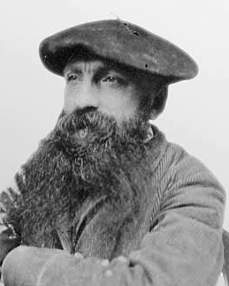




Web Services
A Web service (WS) is a function designed to export data
Input parameters
Outputs an XML document
Web service example: “get artworks by artist name”
input: Rodin → output: XML document with artworks by Rodin
XML tree
Notes:
Again let me give you a brief reminder of what a WS is:
First of all a small introduction to WSs.
WSs are used by data providers as a way of publish or export their data,
They act like functions, so they expect an input and return an output. In this work we consider WS implementing REST and are interfaces to data sources.
In order to use data exported through WSs first of all we have to call the WS.
We need 2 things in order to make a WS call: the URL address of the WS and an input value of a specific type.
For Examples there is a WS exported by music brainz called “getAlbums…”, as we understand this WS takes an input names of artist, so in order to call it first of all we need a URL, the one that we see here and an input value, lets say Rihanna.
The result of this call is an xml document that contains data about the albums of the specific singer.
A method represents for applications what Web forms are for Internet users
Every method is a predefined but unknown parameterized query

Slide 6
Integrating Web Services in a RDF dataset
Idea : Transform the call result into a RDF Fragment
Target DB Schema:
created(author, artwork)
created
created
σ
XML tree
created

Slide 7

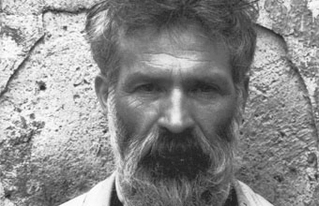


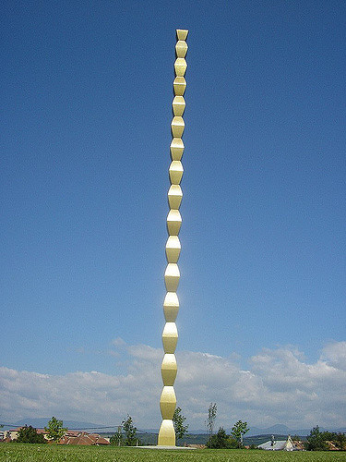
Issue: Limited access
One call unveils a fraction of the source of the Web Service
XML tree
Web service:
“get artworks by artist”
XML tree

Slide 8
Solution: abstract the Web Service as a view
View with limited access pattern = parameterized query
For uniformity, the view is expressed over the target source
Web service:
“get artworks by artist”
input
created
?x
?y

Slide 9
Integration of a Web Service into a RDF dataset
We consider as target schema, the schema a given RDF dataset
Uniform access to Web services (local as view approach):
Infer a parameterized query (intensional description)
Infer a mapping function (transform XML call results → RDF)
→ Problem: Align XML call results & target RDF dataset
Our approach:
Instance Base
Generalizes from a set of call results used as samples
Notes:
The main objective in this part is to ensure that we can provide uniform access to these WSs.
We do that by using as target schema of an existing rdf KB. Like dbpedia….
and we want to define each Web service in terms of the global schema.
In order to achicve this uniformity we need actualy to produce 2 things:

Slide 10

Challenges:
call result for Rodin
bornIn
label
Rodin
URL1
1840
GetArtworksByArtist(Rodin)
RDF fragment at target
root
label
Rodin
bornIn
URI1
1840
item
item
item
created
created
URI2
URI3
y
t
y
t
y
t
year
label
year
label
1908
The
Cathedral
The
Thinker
The
Kiss
1902
The
Thinker
1902
1902
1889
The
Kiss
The labels of XML elements are usually irrelevant
The RDF resources are URIs (typically) known only locally
The input might be missing from the call result

Slide 11
Observations:
GetArtworksByArtist(Rodin)
Path summary for the WS
root
root
*
branching
point
item
item
item
item
y
t
y
t
y
t
y
t
1908
The
Cathedral
1902
The
Thinker
1889
The
Kiss
Typically, a resource is encoded as a sub-tree
Entities with the same role are encoded as sibling sub-trees
Branching point: if sibling XML nodes map to it
→ an embedding of a branching point matches a RDF resource

Slide 12
Idea:
[Taheriyan & all: Rapidly Integrating Services into the Linked Data Cloud
ISWC 2012]
Reduce the problem to an ontology alignment problem:
For each node matching a branching point, construct an RDF resource.
For every path originating in the branching point (in the summary), construct a new RDF property.
Extract the triples corresponding to the new RDF properties.
Apply an ontology alignment solution.

Slide 13
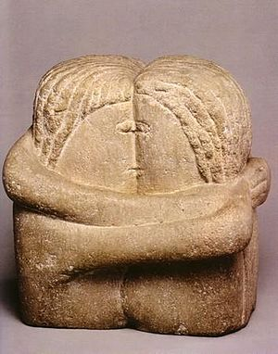
Challenge:
call result for Rodin
bornIn
label
Rodin
URL1
1840
Web Service: “get artwork by title”
GetArtworksByTitle(The Kiss)
r
art
art
created
b
a
y
t
b
a
y
t
1876
Brâncuși
1907
The
Kiss
RDF Fragment
1840
Rodin
1889
The
Kiss
The same node matches several RDF resources
Our approach:
Don’t try to guess the embeddings of the RDF resources
First, match relationships involving literals and learn from them
[Koutraki & all: DORIS, CIKM 2015]

Slide 14
Obs: Linear Paths Encode Semantic Relationships
call result for Rodin
bornIn
label
Rodin
URL1
1840
GetArtworksByTitle(The Kiss)
RDF fragment at target
r
art
year
art
created
label
b
a
y
t
a
y
t
The
Kiss
1889
b
label
birth
1876
Brâncuși
1907
The
Kiss
1840
Rodin
1889
The
Kiss
Rodin
1840
The call result contains data linked to the input
XML text nodes (usually) match RDF literals

Slide 15
Path Alignment
XML
RDF
XML
RDF
XML
RDF
XML
RDF
r
?input
r
?input
r
?input
r
?input
created*
created*
label
year
art*
art*
art*
art*
?x
?x
?l1
?l1
b
birth
a
label*
t
y
text()
?l1
text()
?l2
text()
text()
(artwork, artist’s birthdate)
(artwork, artist’s name)
(artwork, creation year)
(artwork, title)

Slide 16
Metrics for Path Alignments
Overlapping: align two paths if the results of the one overlap the results of the other over a threshold α.
Inclusions: align two paths if the results of the one are included in the results of the other over a threshold α.
Compute both ways inclusions: WS path ⇆ RDF path
Partial completeness assumption: “a source knows either all or none of the p-attributes of some x”
Notes:
In order to compute the confidence score for the path pairs we use 2 strategies.
There are several ways to compute the confidence of such rules but since our data might be incomplete in both sources we use a metric called PCA confidence first introduced in AMIE.
The intuition behind this form is that “ a source knows either all….”
where, p(x,y) is the path from node x to node y, #(x,y): A is the number of pairs (x,y) that satisfies A and |S| is the number of call results.

Slide 17
Class & Relation Alignments
XML
RDF
XML
RDF
XML
RDF
XML
RDF
r
?input
r
?input
r
?input
r
?input
?input
created*
created*
label
year
art*
art*
art*
art*
?x
?l1
?l1
?x
?x
b
birth
a
label*
t
y
text()
?l1
text()
?l2
text()
text()
(artwork, artist’s birthdate)
(artwork, artist’s name)
(artwork, creation year)
(artwork, title)
Idea: starting bottom-up, align functional sub-paths
Assumption: at least a function property per class of entities

Slide 18
Experiments
3 KB Tested ( YAGO, Dbpedia, BNF)
> 50 Web Services
 | Precision |  | Recall
 | Classes | Relations | Classes | Relations
YAGO | 0.92 | 0.91 | 0.96 | 0.93
DBPedia | 0.91 | 0.92 | 0.98 | 0.95
[CIKM2015]

